Slide 1
18ECE220T – Module 4 Cognitive Spectrum Management S – 8, 9
Prepared by
Dr. Diwakar R. Marur
Mr. P. Prabhu--------

Slide 2
S – 8, 9 Spectrum Management

Slide 3
Spectrum Management Challenges
CR networks impose unique challenges due to their coexistence with primary networks as well as diverse QoS requirements.
Critical Design Challenges
Interference avoidance: CR networks should avoid interference with primary networks.
QoS awareness: To decide on an appropriate spectrum band, CR networks should support QoS-aware communication, considering the dynamic and heterogeneous spectrum environment.
Seamless communication: CR networks should provide seamless communication regardless of the appearance of primary users.
To address these challenges, we provide a directory for different functionalities required for spectrum management in CR networks.

Slide 4
4 Steps of Spectrum Management
Spectrum sensing: A CR user can allocate only an unused portion of the spectrum. Therefore, a CR user should monitor the available spectrum bands, capture their information, and then detect spectrum holes.
Spectrum decision: Based on the spectrum availability, CR users can allocate a channel. This allocation not only depends on spectrum availability, but is also determined based on internal (and possibly external) policies.
Spectrum sharing: Because there may be multiple CR users trying to access the spectrum, CR network access should be coordinated to prevent multiple users colliding in overlapping portions of the spectrum.
Spectrum mobility: CR users are regarded as visitors to the spectrum. Hence, if the specific portion of the spectrum in use is required by a primary user, the communication must be continued in another vacant portion of the spectrum.
.

Slide 5
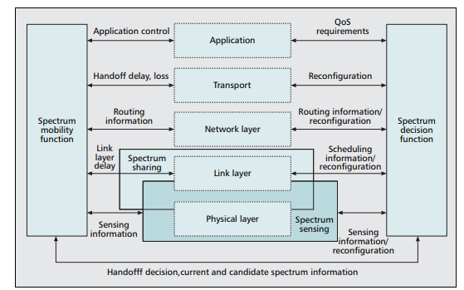
Spectrum management framework for CR
It is evident from the significant number of interactions that the spectrum management functions require a cross-layer design approach
Source: Reference [1]

Slide 6
1. Spectrum Sensing
A CR should be aware of and sensitive to the changes in its surroundings.
Spectrum sensing is an important need for the realization of CR networks.
Spectrum sensing helps to spectrum holes without causing interference to the primary network. This can be accomplished through a real-time wideband sensing capability to detect weak primary signals in a wide spectrum range.
Generally, spectrum sensing techniques can be classified into three groups:
Primary transmitter detection
Primary receiver detection
Interference temperature management

Slide 7
1.1 Primary Transmitter Detection
Transmitter detection is based on the detection of a weak signal from a primary transmitter through the local observations of CR users.
Following three schemes are generally used for transmitter detection:
Matched filter detection,
Energy detection, and
Feature detection
Lack of interactions between primary users and CR users, transmitter detection techniques rely only on weak signals from the primary transmitters. Hence, transmitter detection techniques alone cannot avoid interference to primary receivers because of the lack of primary receiver information as depicted in Fig. 4a.

Slide 8
1.1 Primary Transmitter Detection (2)
Transmitter detection models cannot prevent the hidden terminal problem. A CR user (transmitter) can have a good line of sight to a CR receiver but may not be able to detect the primary transmitter due to shadowing, as shown in Fig. 4b.
For accurate primary transmitter detection go for cooperative detection.
Advantages
Cooperative detection is theoretically more accurate because the uncertainty in a single user’s detection can be minimized through collaboration.
Moreover, multipath fading and shadowing effects can be mitigated so that the detection
Disadvantage:
Causes adverse effects on resource constrained networks due to the overhead traffic required for cooperation.

Slide 9
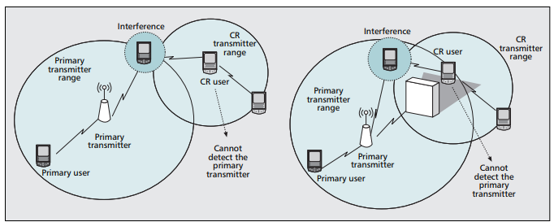
1.1 Transmitter detection problem
Figure 4 (a) receiver uncertainty; 4 (b) shadowing uncertainty.
Source: Reference [1]

Slide 10
1.2 Primary Receiver Detection
Although cooperative detection reduces the probability of interference, the most efficient way to detect spectrum holes is to detect the primary users that are receiving data within the communication range of a CR user.
Usually, the Local Oscillator (LO) leakage power emitted by the RF front-end of the primary receiver is exploited.
However, because the LO leakage signal is typically weak, implementation of a reliable detector is not trivial.
Currently, this method is only feasible in the detection of TV receivers.

Slide 11
1.3 Interference Temperature Management
Traditionally, interference can be controlled at the transmitter through the radiated power and location of individual transmitters. However, interference actually takes place at the receivers, as shown in Fig. 4a.
New model for measuring interference, referred as Interference Temperature (InT), is introduced by the Federal Communications Commission (FCC).
This model limits the interference at the receiver through an InT limit, which is the quantum of interference the receiver could tolerate.
As long as CR users do not exceed this limit, they can use the spectrum band. This model faces the difficulty in accurately determining the InT limit.

Slide 12
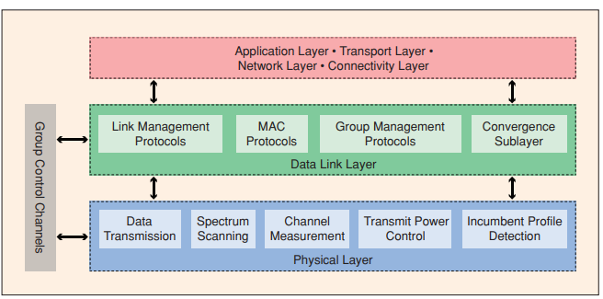
1a. Spectrum Sensing – PHY & MAC Layers
Figure: A generic layered protocol architecture for a CR system Source: Reference [2]

Slide 13
1a. Spectrum Sensing – Cross Layer
A. Physical-Layer Sensing Methods
Bandwidth, resolution, and real-time capability are the widely employed metrics to evaluate performance of spectrum sensing algorithms.
Bandwidth - spectrum range that is covered by the sensing CR. A wider bandwidth leads to a greater capacity of CR systems.
Resolution is the smallest spectrum step based on which the whole bandwidth range is quantized.
Real-time capability is the time taken for a CR to reliably sense the environment and then make adaptive decisions. Thumb rule is the sensing latency should be less than coherence time of the channel. (Assumption: Time varying channel)
The spectrum sensing algorithm design is essentially to find an optimized tradeoff between these metrics.
All non-cooperative sensing comes under physical-layer sensing methods

Slide 14
1a. Spectrum Sensing – Cross Layer
B. Cooperative Spectrum Sensing
A more promising solution is to allow the sensing information to be shared among local cognitive users so that the spectrum sensing is performed collectively rather than individually across different network layers.
The obtained physical-layer spectrum usage status is reported to the MAC layer. The MAC will then allocate the available spectrum to establish a safe CR link.
Cooperative sensing will reduce the probability of interference to a primary user and in turn alleviate the problem of detecting the primary user.
In cooperative sensing we rely on the variability of signal strengths at various locations.
Spectrum sensing is best addressed as a cross-layer design problem.

Slide 15
2. Spectrum decision
SPECTRUM DECISION: CR networks require the capability to decide which is the best spectrum band among the available bands according to the QoS requirements of the applications.
Spectrum decision is closely related to the channel characteristics and operations of primary users. Furthermore, spectrum decision is affected by the activities of other CR users in the network.
Step ONE: Each spectrum band is characterized, based on not only local observations of CR users but also statistical information of primary networks.
Step TWO: Based on this characterization, the most appropriate spectrum band can be chosen.

Slide 16
2.1 Channel Characteristics
Spectrum holes characteristics vary over time, each spectrum hole should be characterized considering both the time-varying radio environment and spectrum parameters, such as operating frequency and bandwidth.
Essential parameters for a particular spectrum band as follows:
Interference
Path loss
Wireless link errors
Link layer delay

Slide 17
2.2 Decision Procedure
After the available spectrum bands are characterized, the most appropriate spectrum band should be selected, considering the QoS requirements and spectrum characteristics. Accordingly, the transmission mode and bandwidth for the transmission can be reconfigured.
To describe the dynamic nature of CR networks, a new metric — primary user activity — is proposed.
It is defined as the probability of a primary user appearance during CR user transmission.
Because there is no guarantee that a spectrum band will be available during the entire communication of a CR user, it is important to consider how often the primary user appears on the spectrum band.
Due to the operation of primary networks, CR users cannot obtain a reliable communication channel for a long time period.
Sometimes, CR users may not detect any single spectrum band to meet the user’s requirements

Slide 18
3. Spectrum Sharing
The shared nature of the wireless channel requires the coordination of transmission attempts between CR users.
Spectrum sharing should include much of the functionality of a MAC protocol. Moreover, the unique characteristics of CRs, such as the coexistence of CR users with licensed users and the wide range of available spectrum, incur substantially different challenges for spectrum sharing in CR networks.
Spectrum can be classified by four aspects:
The architecture,
Spectrum allocation behavior,
Spectrum access technique,
Scope.

Slide 19
3. Classification Spectrum Sharing Techniques
TYPE 1
Centralized spectrum sharing
Distributed spectrum sharing
TYPE 2
Cooperative spectrum sharing
Non-cooperative spectrum sharing
TYPE 3
Overlay spectrum sharing
Underlay spectrum sharing
TYPE 4
Intranetwork spectrum sharing
Internetwork spectrum sharing

Slide 20
TYPE 1 (Spectrum Sharing Technique)
A. Centralized spectrum sharing
The spectrum allocation and access procedures are controlled by a central entity.
A distributed sensing procedure is used make spectrum measurements and forward it to the central entity. Using this a spectrum allocation map is constructed.
Central entity can lease spectrum to users in a limited geographical region for a specific amount of time. Leasing leads competition for users.
B. Distributed spectrum sharing
Spectrum allocation and access are based on local (or possibly global) policies* that are performed by each node distributively.
Distributed solutions also are used between different networks such that a base station (BS) competes with its interferer BSs according to the QoS requirements of its users to allocate a portion of the spectrum.
*Policy – Set of rules

Slide 21
TYPE 2 (Spectrum Sharing Technique)
A. Cooperative spectrum sharing
Cooperative (or collaborative) solutions exploit the interference measurements of each node such that the effect of the communication of one node on other nodes is considered.
Nodes form a clusters to share interference information locally. This localized operation provides an effective balance between a fully centralized and a distributed scheme.
B. Non-cooperative spectrum sharing
Only a single node is considered here.
As other CR nodes interference not considered, spectrum utilization is reduced.
No need of frequent message exchanges between neighbors as in cooperative solutions.
Non-cooperative sensing performing poorly and lacks fairness compared to cooperative sensing

Slide 22
TYPE 3 (Spectrum Sharing Technique)
A. Overlay spectrum sharing
Nodes access the network using a portion of the spectrum that has not been used by licensed users.
This minimizes interference to the primary network.
B. Underlay spectrum sharing
The spread spectrum techniques are exploited such that the transmission of a CR node is regarded as noise by licensed users.

Slide 23
TYPE 4 (Spectrum Sharing Technique)
A. Intra-network spectrum sharing
These solutions focus on spectrum allocation between the entities of a CR network, as shown in Fig. 6.
Here the users of a CR network try to access the available spectrum without causing interference to the primary users.
This method poses unique challenges. These problems are unknown in wireless communications systems
B. Internetwork spectrum sharing
The CR architecture enables multiple systems to be deployed in overlapping locations and spectrum, as shown in Fig. 6.
This type of solutions provide a broader view of the spectrum sharing concept by including certain operator policies.

Slide 24
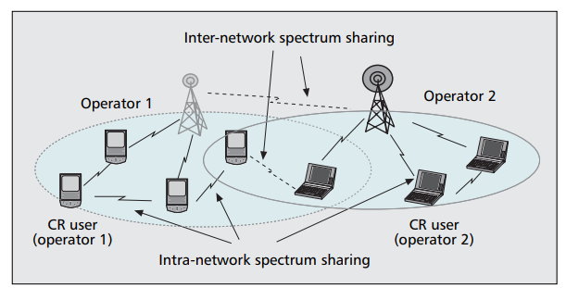
TYPE 4 (Spectrum Sharing Technique) Contd…
Figure 6. Inter-network and intra-network spectrum sharing in CR networks.

Slide 25
4. Spectrum Mobility
After a CR captures the best available spectrum, primary user activity on the selected spectrum may necessitate that the user change its operating spectrum band(s), which is referred to as spectrum mobility.
Spectrum mobility gives rise to a new type of handoff in CR networks, spectrum handoff.
Protocols for different layers of the network stack must adapt to the channel parameters of the operating frequency.
Protocols should be transparent to spectrum handoff and the associated latency.
Each time a CR user changes its frequency of operation, the network protocols may require modifications to the operation parameters.

Slide 26
4. Spectrum Mobility (2)
Spectrum mobility ensures smooth and fast transition leading to minimum performance degradation during a spectrum handoff.
Information about the duration of a spectrum handoff is an important information. It is provided by the sensing algorithm.
After the latency information is available, the ongoing communications can be preserved with only minimum performance degradation.
The intrinsic characteristics of a CR network give rise to two novel concepts:
Spectrum mobility
Spectrum handoff.

Slide 27
References
Akyildiz IF, Lee WY, Vuran MC, Mohanty S., “A survey on spectrum management in cognitive radio networks”, IEEE Communications magazine, vol. 46, no. 4, pp. 40–48, 2008.
Hong, X., Chen, Z., Wang, C.X., Vorobyov, S.A. and Thompson, J.S., “Cognitive radio networks,” IEEE vehicular technology magazine, vol. 4, no. 4, pp.76-84, 2009.
First Paper in Cognitive Radio
Mitola, Joseph, and Gerald Q. Maguire. “Cognitive radio: making software radios more personal”, IEEE personal communications, vol. 6, no. 4, pp. 13–18, 1999.

Slide 28
Thank You

